Slide 1
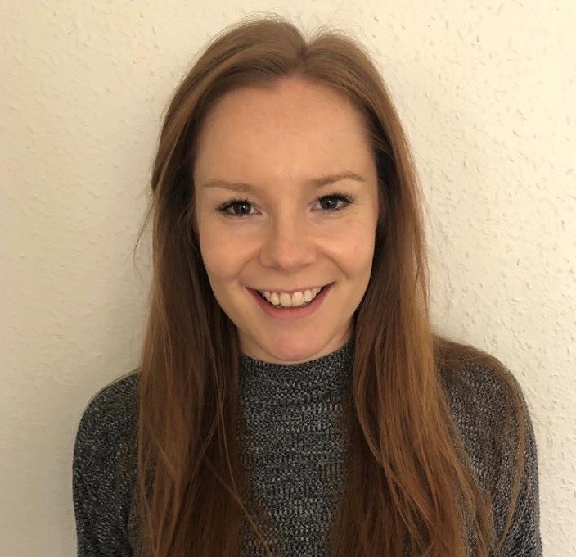

Rosie Grant
SafeguardingTeam@orchardparkhigh.net

Slide 2
What is anxiety and
how do we manage it?

Slide 3

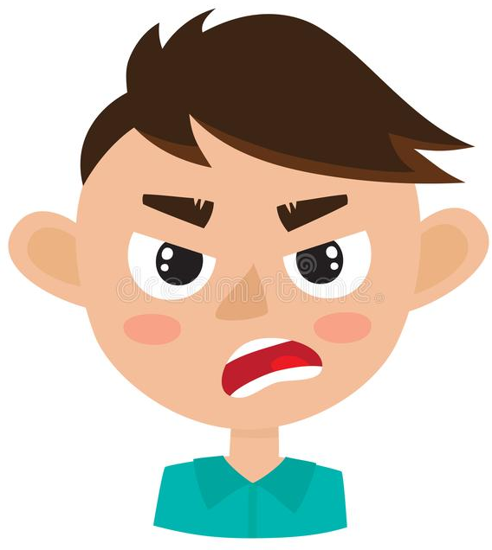


Recognising Anxiety
Racing Heart
Feeling more irritated or grumpy because you’re worried
Difficulty Sleeping
Problems Breathing
Headaches
Sweaty Palms
Upset Stomach
Muscle Tension

Slide 4

This is your body’s normal response to a situation that might be harmful.
The problem with anxiety is that it can interfere in situations that are totally harmless such as being at home or at school.
These feelings can be distressing and a bit of a false alarm.

Slide 5

The problem with these feelings is that it can make us think we can’t handle what is coming even though it is an every day situation.

Slide 6
When we’re feeling anxious we tend to think about the worst case scenario even though there are lots more likely outcomes.
I’m going to get shouted at
Everyone will laugh at me
What if I totally fail?!?

Slide 7
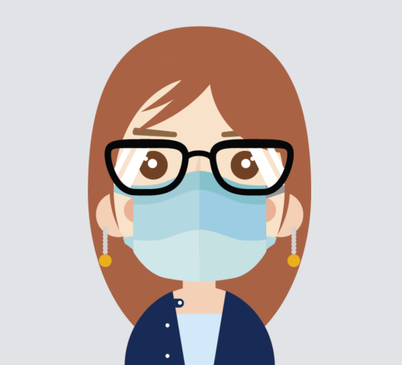
It’s normal to feel worried and people feel anxious about lots of different things. Most people are feeling more anxious at the moment because there is lots of change.

Slide 8

If you notice that you’re stuck in these feelings and you’re feeling more anxious and distressed than usual then there are strategies that can help.

Slide 9

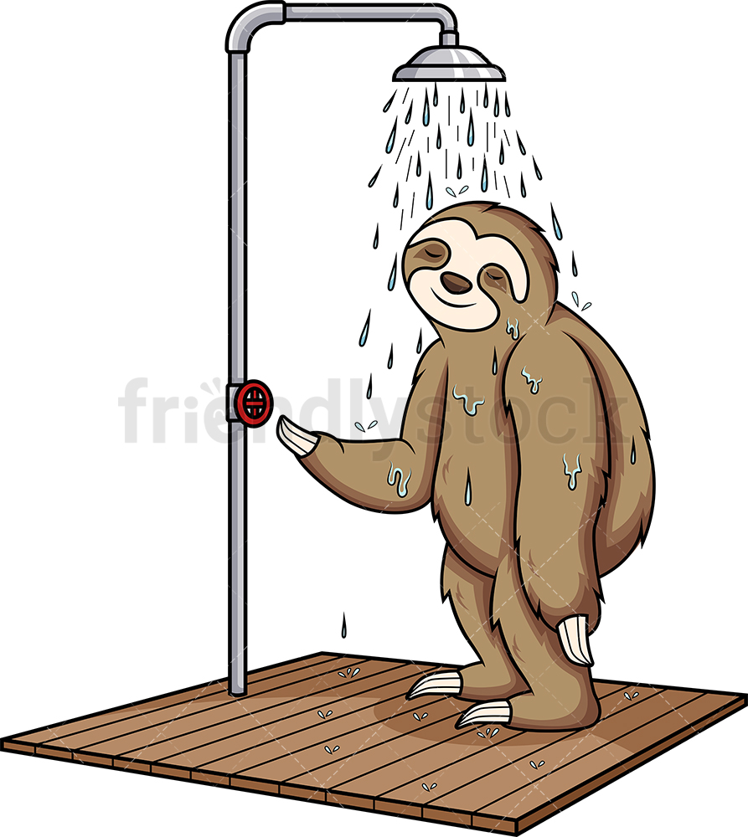
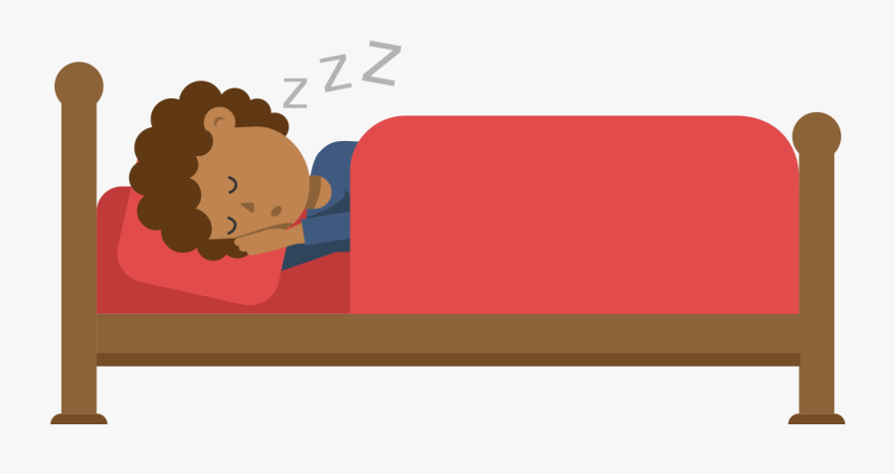
There are actions we can take to help us feel better…
Exercise
Self-Care
- Showering
Brushing your teeth
Put on some clean clothes
Good Habits
and
Routines
Getting good sleep

Slide 10
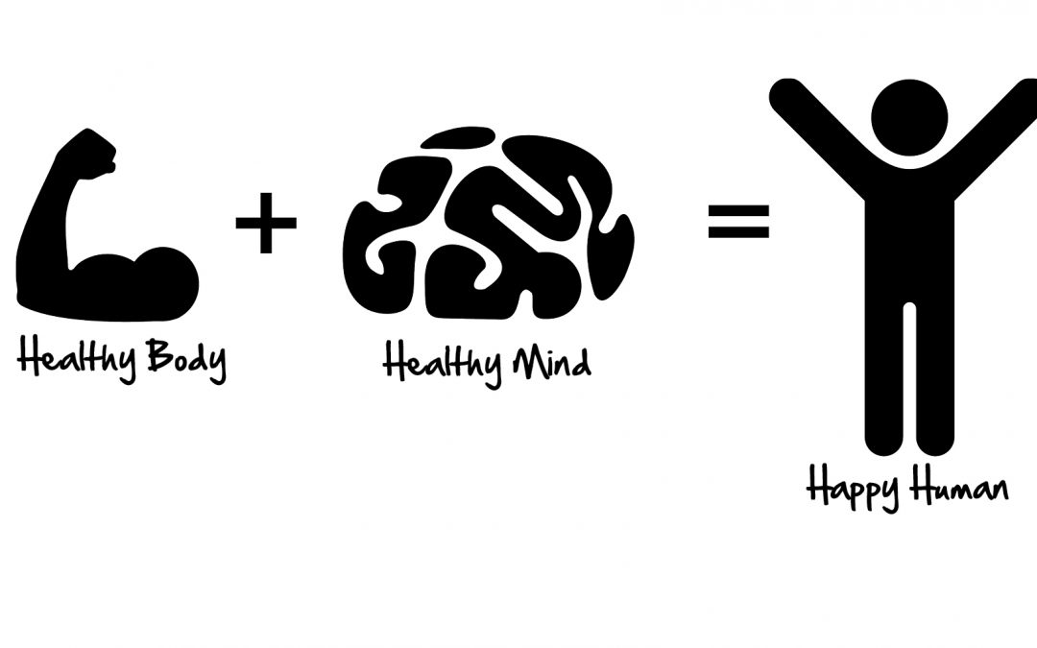

Slide 11

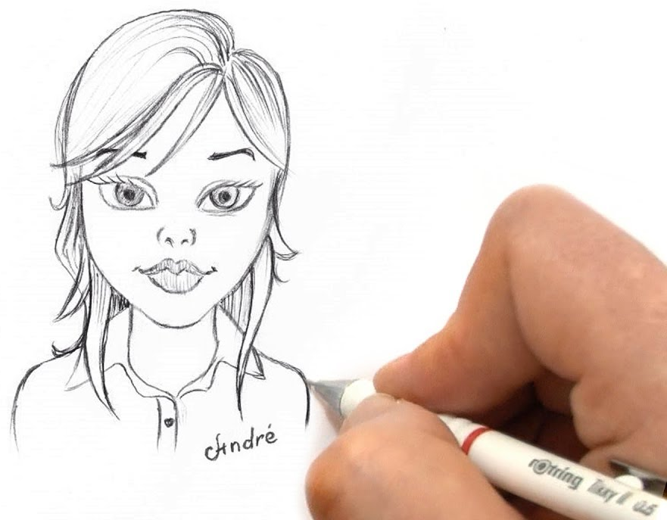

Do an activity that you enjoy
Cooking / Baking
Talk to a friend on the phone
Sketching / Art
Listen to music – make a playlist
Play a game

Slide 12
Carrying on doing things that are important to us (even if we feel uncomfortable).
We tend to avoid to avoid situations that make us feel nervous.
But the more we avoid these situations, the more we stay nervous.
This might include going to school, seeing friends, talking on the phone or going to certain places.

Slide 13
If you’re feeling overwhelmed then it’s good to talk to a helper.
Who are the people that can help me in this situation?
I’m not feeling too good…can we talk?
Teachers
Family members
Friends
Doctors
Social Worker

Slide 14
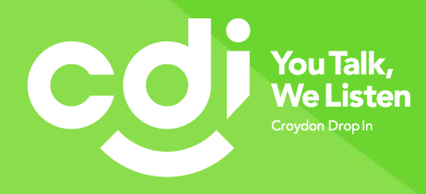
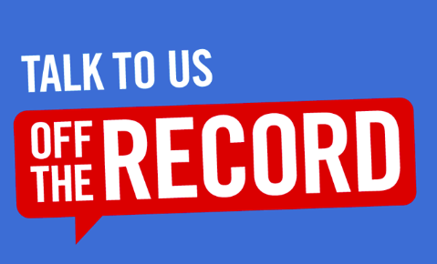
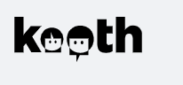
There are also some mental health and wellbeing services in Croydon that are available to students and young people.
Tel: 020 8680 0404
Email: enquiries@croydondropin.org.uk
http://croydondropin.org.uk/
Tel: 020 8251 0251
Email: croydon@talkofftherecord.org
www.talkofftherecord.org
https://www.kooth.com/

Slide 15

And remember to BREATHE!

